Slide 1

Eco-Ambassadors Condensed Program
Boston Campus
January 25, 2012

Slide 2
From last week…
Role description revisited
How did your office introduction go?
Recycling survey and audit
Notes:
Role description revisited – what do/don’t you like about it?
Introductions – how did it go? Were people in the office excited? supportive? Indifferent?
Hand out GOC if they are done
Tina

Slide 3
Transportation

Slide 4
Tufts’ 2010 Emissions
(all campuses)
Notes:
For all 3 Tufts campuses, transportation accounts for only 4% of emissions – but in the US as a whole, transportation accounts for 27% of emissions

Slide 5
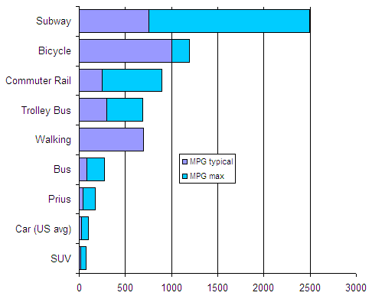
Notes:
Driving in an SUV is, unsurprisingly, the worst transportation option in terms of fuel used and CO2 emissions
Walking, biking, and taking a bus or train are the best

Slide 6
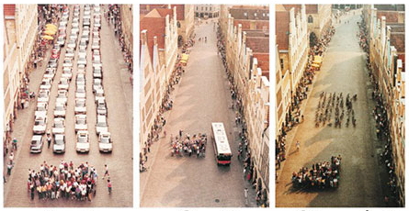
Amount of space needed to transport the same number of passengers by…
Car
Bus
Bicycle
Notes:
It’s also much more space-efficient to ride a bike or take public transit than it is to drive

Slide 7
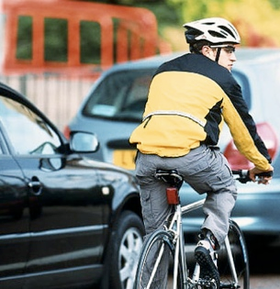
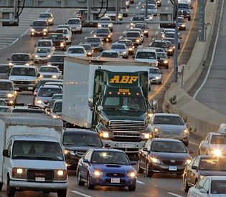
Tufts Boston Facts
54% of Tufts Boston employees who live within 7 miles of campus drive to work
  Half of these employees drive alone
Notes:
3 million commuters in Boston, 74% drive alone
Car commuting causes over 50% of New England’s ozone-forming pollutants.
Just over half of Tufts Boston employees who live within 7 miles drive to work
46% Tufts Boston employees who drive, drive alone
We’re doing better than the Boston average, but with so many alternative transportation options, why drive?
Ask – how many take different forms of transport?
7

Slide 8
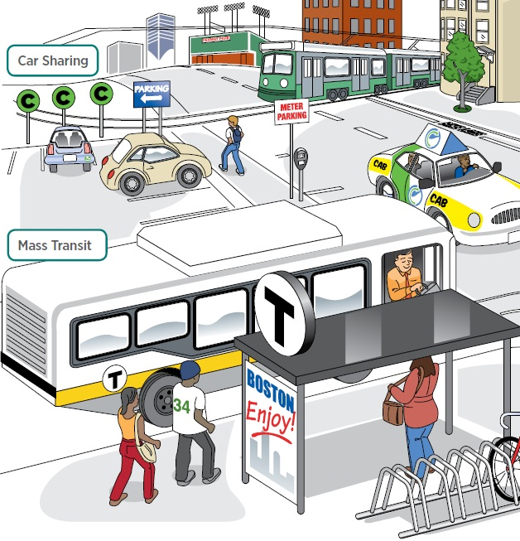
Source: A Climate of Progress: City of Boston Climate Action Plan Update 2011
Notes:
Luckily for us, in Boston, there are lots of great alternative transportation options
Car sharing programs enable you to get around without needing to own a car yourself
Ride-sharing programs are a way to carpool with others and meet new people
The T and commuter rail are reliable, clean, and comfortable ways to get around
Tufts offers pre-tax purchasing of transit passes (for single and multiple passes) and a 25% discount on all transit passes (purchase through HR)
Plus, a lot of places are within walking or biking distance
8

Slide 9
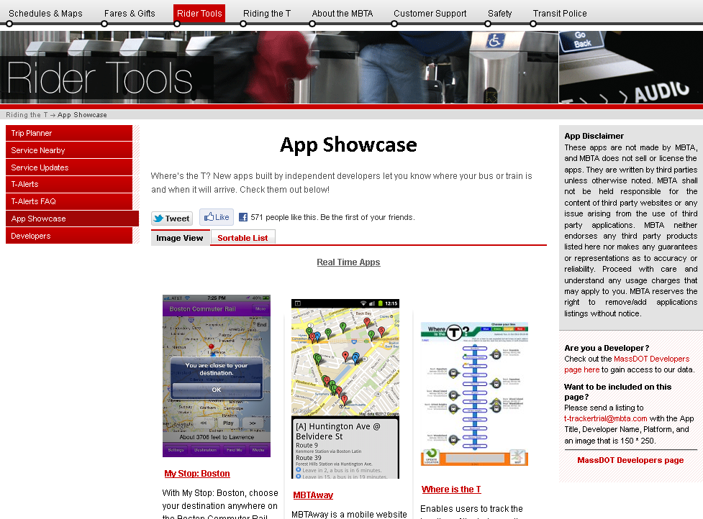
mbta.com/rider_tools/apps/
Notes:
MBTA offers many apps for your phone, available on the MBTA website, that make taking the T or commuter rail easier (ex: NextBus tells you when the next bus arrives, if you don’t have a smartphone, you can text the bus number to a MBTA service to find out its schedule)

Slide 10


Tufts/ABC TMA partnership
  Ride matching and other perks with
  Guaranteed ride home
  Workout to work
  Cash incentives
More information: www.abctma.com/programs/index.htm
Notes:
Tufts/ABC TMA partnership
Ride matching through Nuride (secure and easy system that helps you find carpooling partners)
Nuride also allows you to log up to 2 alternative transportation trips per day (walk, bike, carpool, public transit), can be for commuting or personal use
Eligible to get rewards from local restaurants and local/national retailers just for taking public transit
Guaranteed ride home (you can get up to 6 rides free each year), so if you or a carpooling buddy have an emergency, you can get home safely and for free
Workout to work (if you walk or bike to work, you can win great commuter prizes, like workout gear and gift cards)
Cash incentives
3 months free on any MBTA express bus, commuter boat, or private bus
If you carpool, you can get $35 per month for gas expenses
If you start a vanpool, you can be reimbursed $220 over 6 months

Slide 11

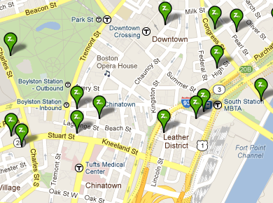
Tufts membership for $25/year
$9+/hr., including gas and insurance
More information:
www.zipcar.com/tufts (Tufts employees)
www.zipcar.com/abctma (Medical Center employees)
Notes:
Zipcar is a short-term car rental service co-founded by one of Tufts’ employees, Antje Danielson
Several Zipcar locations (see map)
Tufts offers Zipcar membership at 50% off ($25/year)
$9+/hr., including gas and insurance

Slide 12

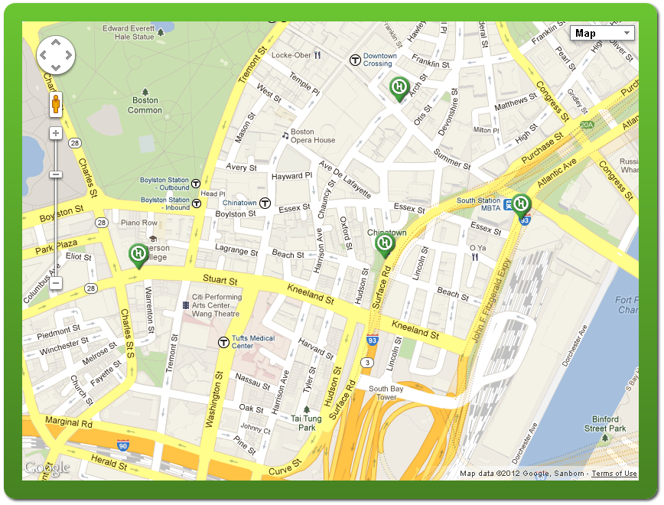
New bike-sharing system that began in 2011
600+ bicycles when they started
  you can rent by the hour, day, or year
More information: www.thehubway.com

Slide 13
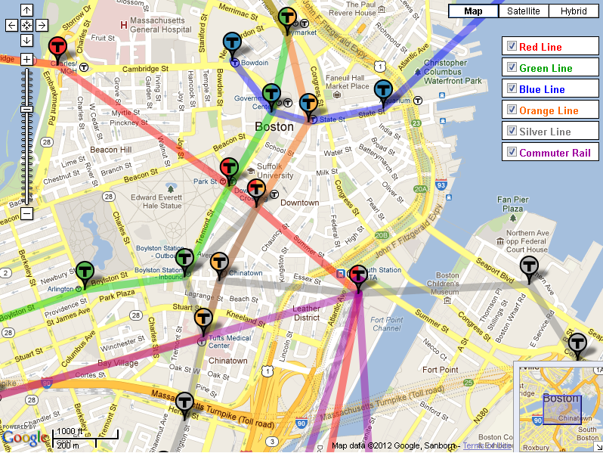
Notes:
Working in Boston, you can easily get around on the T or commuter rail

Slide 14
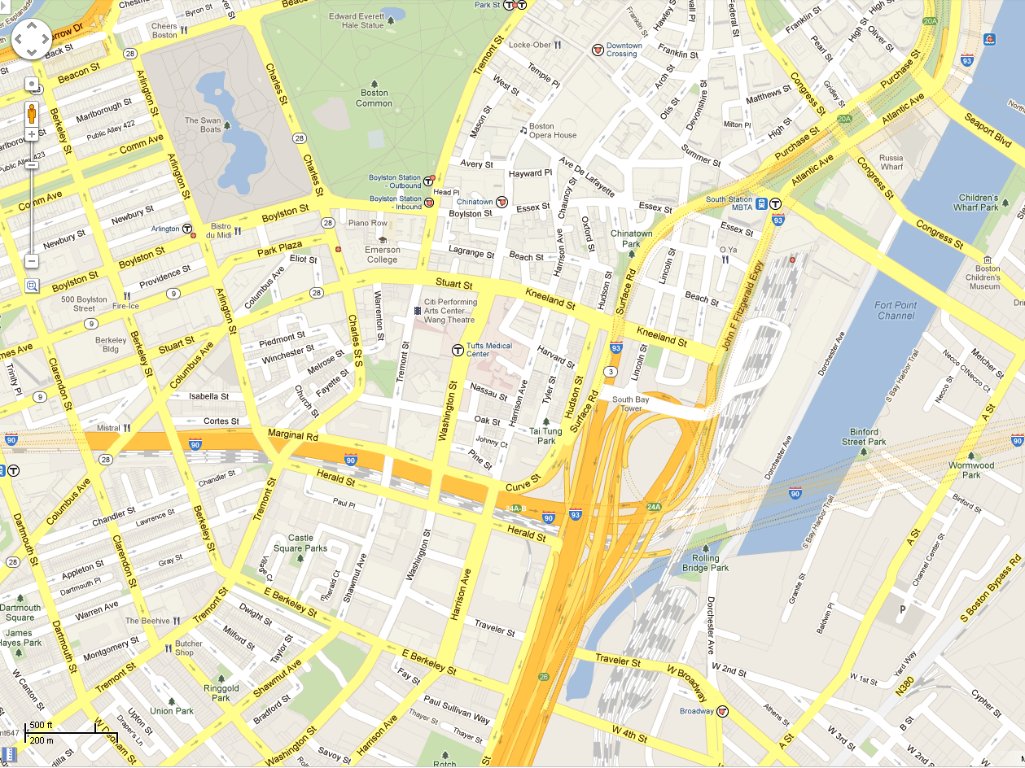
5 minute walk
10 minute walk
Notes:
The T is less than a 5 minute walk, and you can get to South Station in 10 minutes
If you want to get some exercise and do something good for the planet, in only a 10 minute walk, you can get quite a ways in Boston – enjoy Boston Common for some relaxation or enjoy lunch at one of the many restaurants in the area.

Slide 15

Notes:
How you get around your office is important, too – this poster (a prompt!) from Johns Hopkins University quickly and clearly explains why you should take the stairs instead of the elevator
Has anyone seen a similar poster in Jaharis?
If it’s difficult to access the stairs in your building, talk to a supervisor to see if increased access might be possible
a former EA, Heather Angstrom, did a whole project on effective prompts, so it could be useful to talk to her

Slide 16
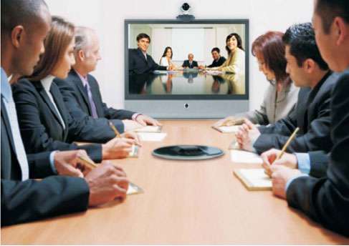
Videoconferencing locations
  Sackler 114 & 802
  Jaharis 118, 130, & 272
  Dental 619 & 1414
  2 mobile videoconferencing units in Sackler & Dental
Movi/Jabber, Adobe Connect, Skype from your desk
More info: http://uit.tufts.edu/voiceservices/?pid=25 or contact Sumirko Oei
Notes:
Videoconferencing is a great way to be more sustainable, as it lets you hold meetings virtually
Try it out and recommend it to your colleagues
It saves travel time and reduces environmental impact
There are several videoconferencing rooms in Boston, plus 2 mobile units
You can also videoconference with Movi (now Jabber), Adobe Connect, or Skype from your desk
UIT is very helpful – visit their website if you need help setting up a videoconference or contact Sumirko Oei

Slide 17
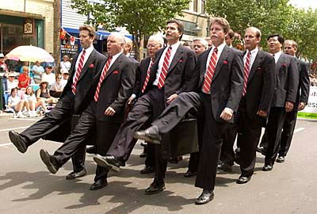
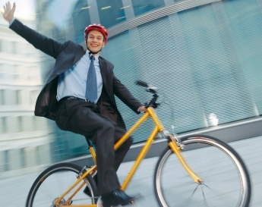
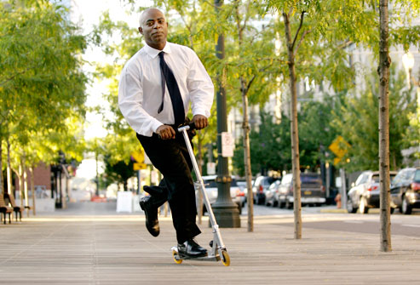
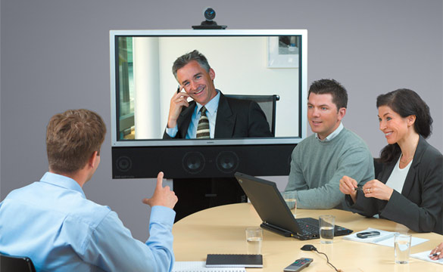
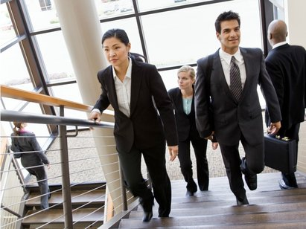
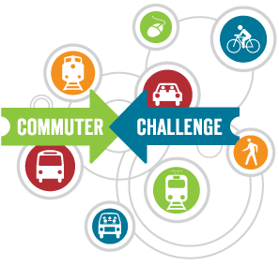
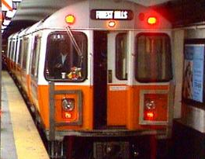
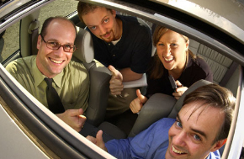
Ideas for your office
Walk, bike, take the T or bus, or carpool
  Share information with others
  Calculate commuter cost - http://www.commute.com/commuters/calculator
Encourage office videoconferencing
Take the stairs for exercise
Start an office challenge
Green Streets Walk/Ride Day Corporate Challenge
Notes:
Walk, bike, take the T, take the bus, or carpool to and from work, as well as between campuses, and provide information on alternative transportation options in your office
Share this pamphlet/information with others
Especially share information about incentives (ABC TMA, Tufts MBTA discount, Nuride)
Have your officemates calculate the real cost of owning a car http://www.commute.com/commuters/calculator
Encourage taking the train instead of flying for places less than 250 miles away (see if you can offer a small incentive?)
Have office commuting buddies that carpool or take the bus/train together – set up a google earth map that shows where people live (first names, towns/streets) to more easily find people who leave near each other)
Encourage office videoconferencing instead of business travel, even between campuses
Take the stairs for exercise – and put up prompts like those in Jaharis to remind people of the benefits
Have office challenges – who can carpool the most in a month, etc.
Bay State Bike Week events (May 14-20, 2012) – have an “alternate commute to work week with a raffle”

Slide 18
Purchasing
Notes:
While it’s always best to reduce and reuse, when we need to buy new things, it’s important to know what the most sustainable option(s) are.
tina

Slide 19
Green Claims – “Green” or Greenwashing?
Between 2009 and 2010, the number of “green” products increased 73%.
Source: TerraChoice
Notes:
A lot of companies try to sound green – how do you know what’s real?
Greenwashing describes products that use a label or description that sounds sustainable, but isn’t (company intentionally misleads a consumer)
Number of overall greenwashing claims is declining, but a rise in vague or unfounded claims
Legitimate standards combat greenwashing, so you need to know what to look for
First party certifications (have not been tested/verified, most are marketing claims, often greenwashing)
Third party certifications (a 3rd party independently tests product and grants certifications, can be meaningful or greenwashing)

Slide 20























Green (Reliable)
Greenwashing (Unreliable)

Slide 21

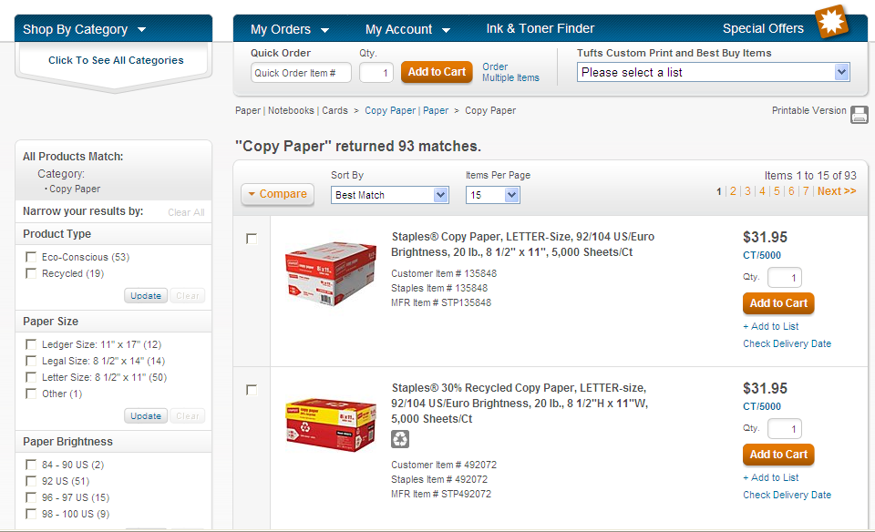
https://tufts.orgsupply.net
Notes:
Note 30% recycled content is the same price as ‘regular’ (screen shot taken 8/14/12)
Also note ability to sort by Eco-Conscious and Recycled (click for box)

Slide 22
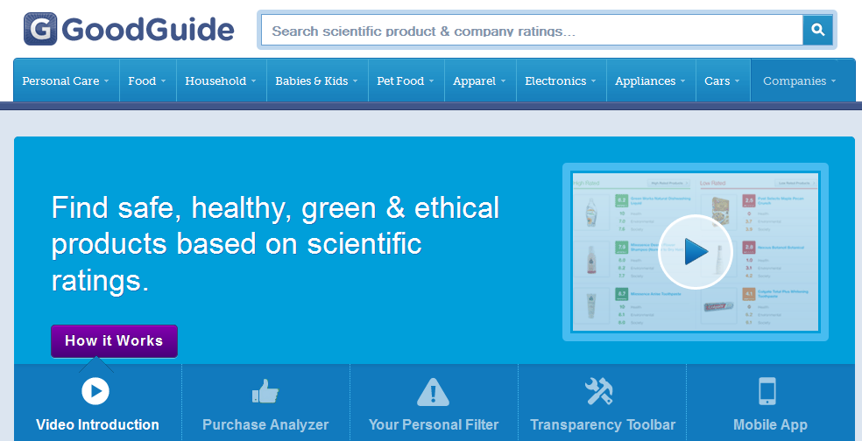
Notes:
GoodGuide rates products on environmental, social, and economic criteria
You can download the GoodGuide Transparency Toolbar, supported by Amazon, Google, and other major retailers and search engines
Instantly evaluates the product you choose based on your own criteria
You can also download an app if you have a smartphone, that will allow you to scan product barcodes and get the information instantly

Slide 23
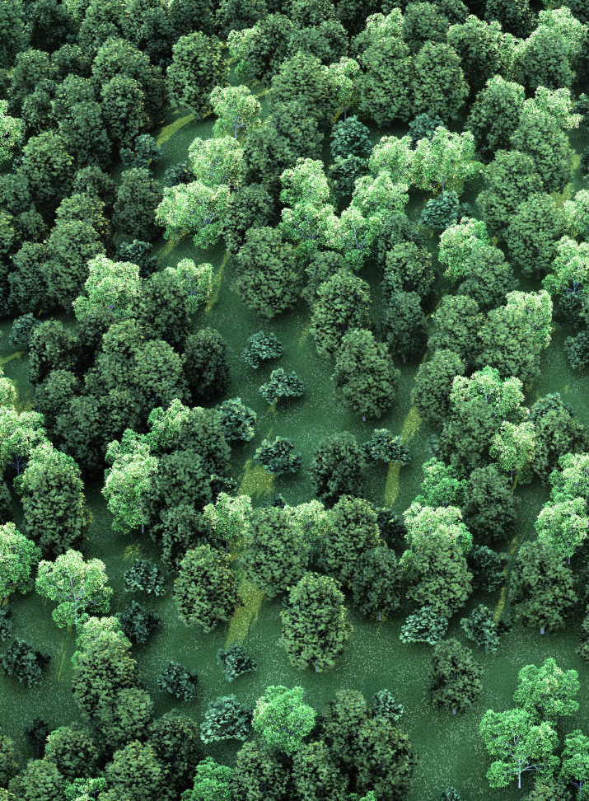
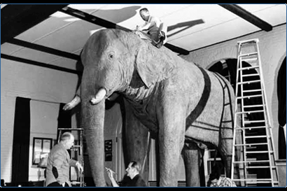
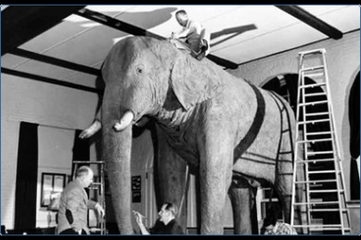
Paper
In FY ‘11 Tufts purchased 252,624 lbs. of paper
Average recycled content: 34%
Notes:
FY 11, purchased 252,624 lbs paper, with 34% average recycled content
Equivalent to 19 six metric ton Jumbos (we saved a whole Jumbo’s worth of paper, 12000 lbs, from FY 10)
Buying recycled content vs. virgin paper saved 1113 trees, and the equivalent energy needed to provide electricity to 8.8 US homes for a year
When buying paper in your office, strive for 100% recycled or FSC-certified paper.
dani

Slide 24
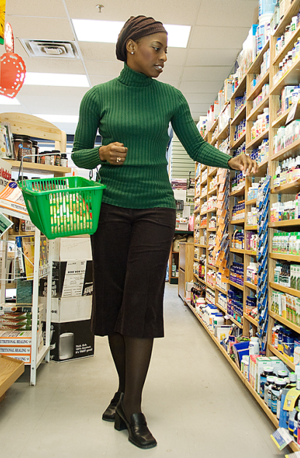
What can you do in your office?
Reduce and reuse first
When you buy, buy sustainable
  “Buy green, buy fair, buy local, buy used, and most importantly, buy less.” – Story of Stuff
Talk with co-workers, purchasing staff, and suppliers
Notes:
Reduce and reuse first – it’s best to avoid purchasing new things
When you buy, buy sustainable
consider watching the online film Story of Stuff to explain the problems behind overconsumption
Use the Tufts Marketplace to find green products (Staples EcoEasy button, CDW, Dell) – more info on the OOS website
Look for reputable labels and claims on GreenGuide and other sites
Buy from local suppliers
Make purchasing decisions about quality/durability, not just price
Consult EPA’s Environmentally Preferable Purchasing site for more info on specific green products and these labeling sites for more info on green labels.
Talk with your co-workers, purchasing staff, and suppliers
Tell your suppliers about your interest in green products and pass the word to co-workers on how important and easy it is to buy green (educate them on labels, too, so they know what to look for)
Find green vendors through Co-op America’s Green Pages
Ask Tufts purchasing staff about eco-friendly options for the items you are looking for.
Be clear about what you want when asking someone else to order for you
dani

Slide 25
Helpful Purchasing Resources
Tufts Purchasing Department
  http://finance.tufts.edu/purchasing/
Purchasing Guides
  http://www.goodguide.com/
  http://www.ewg.org/skindeep/
  http://www.responsiblepurchasing.org/purchasing_guides/all/standards/
  www.epa.gov/epp
Eco-Labeling
  http://www.epa.gov/epp/pubs/labeling.htm
  http://www.nrdc.org/living/labels/cleaning.asp
Food Labeling
  http://www.earthwatch2.org/sustainability/decoding%20labels.htm
  http://www.ewg.org/meateatersguide/decoding-meat-dairy-product-labels/
Green Printing at Tufts
  http://sustainability.tufts.edu/?pid=109&c=48
Notes:
25

Slide 26
Water
Notes:
Does anyone know how much water in the world is saltwater?
TINA

Slide 27
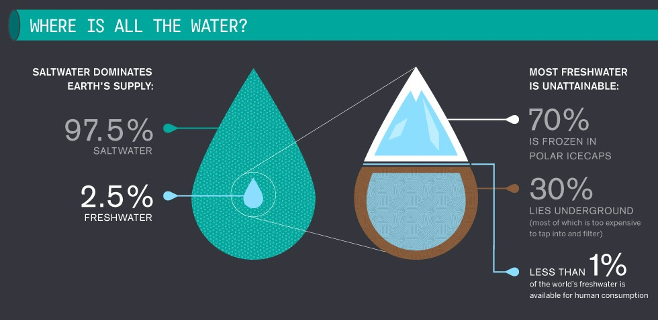
Source: http://awesome.good.is.s3.amazonaws.com/transparency/web/1106/clean-water/flat.html
Notes:
While there is a lot of water in the world, most of it is saltwater – 97%
Less than 3% of all water is freshwater, and most of that is unattainable
Less than 1% of all water is available for human consumption as accessible freshwater
As human populations grow, the amount of freshwater available per person shrinks
This small amount of freshwater makes water conservation and maintaining clean water supplies especially important

Slide 28
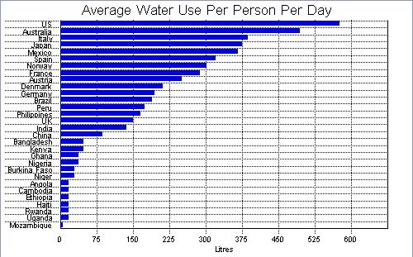
Source: http://www.data360.org/dsg.aspx?Data_Set_Group_Id=757
Notes:
As you can see, Americans use more water per person than anywhere else in the world

Slide 29
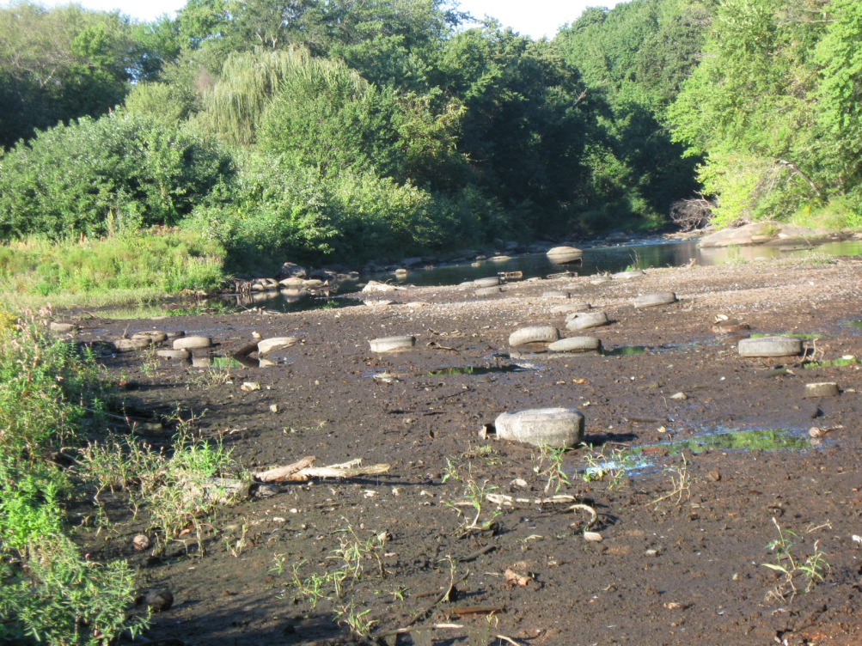
Source: http://www.trashpaddler.com/2010_09_01_archive.html
Notes:
In New England, this can be problematic, as many of the rivers dry out in the summer, because too much water is drawn from them.
With climate change, we can expect to get more summer droughts in the Northeast.
These exacerbate water concerns

Slide 30

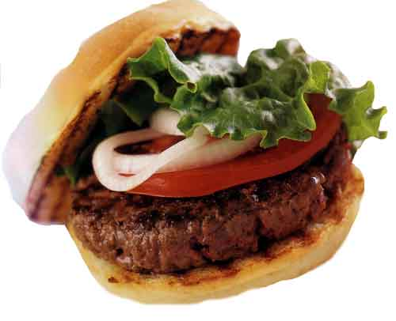
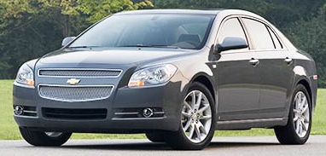

How many gallons of water does it take to make…
35 – 53 Gallons
4,000 – 18,000 Gallons
1.85 Gallons
41,000 Gallons
Notes:
You can also reduce your water use through everyday choices
1 cup coffee = 35 gallons (120 billion metric tons worldwide to make coffee), 53 gallons to make a latte
Hamburger = 4,000 - 18,000 gallons
Car = 39, 090 gallons, plus 2000 gallons for the tires
Bottle of water = 1.85 gallons just to make the bottle, plus the water inside

Slide 31
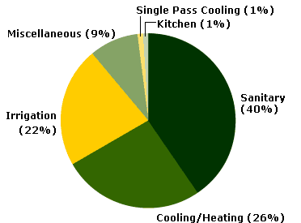
Typical office water use
Source: http://www.epa.gov/oaintrnt/water/lab_vs_office.htm
Notes:
Nationally, Largest office water uses are for Sanitary = 40 percent, Cooling Tower Make-up water = 26 percent, Irrigation = 22 percent
Sanitary uses include faucets and toilets – find out if your office has water-conserving versions of these

Slide 32
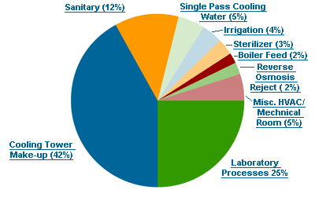
Typical lab water use
Source: http://www.epa.gov/oaintrnt/water/lab_vs_office.htm
Notes:
In a lab, less water is used for sanitary purposes, and more for the cooling tower (42%) and lab processes (25%)
Many lab processes use a lot of water, but there are opportunities to reduce your water use
If your office has a water still to purify water, talk with a supervisor about the possibility of getting a reverse osmosis or ion exchange method of purification
You can also use a plug or basin in the sink to collect water for rinsing and reuse instead of a constantly running the tap
Can anyone who works in a lab think of other ways to conserve water?

Slide 33
Notes:
This is what our consumption profile/per campus looks like
Boston’s water consumption has been relatively stable

Slide 34
Notes:
Still, Boston spends nearly $500,000 each year on water

Slide 35
Notes:
Boston’s main water users are M&V, Jaharis, and Dental

Slide 36
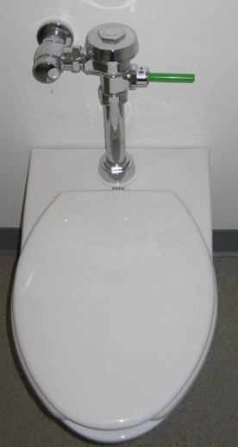
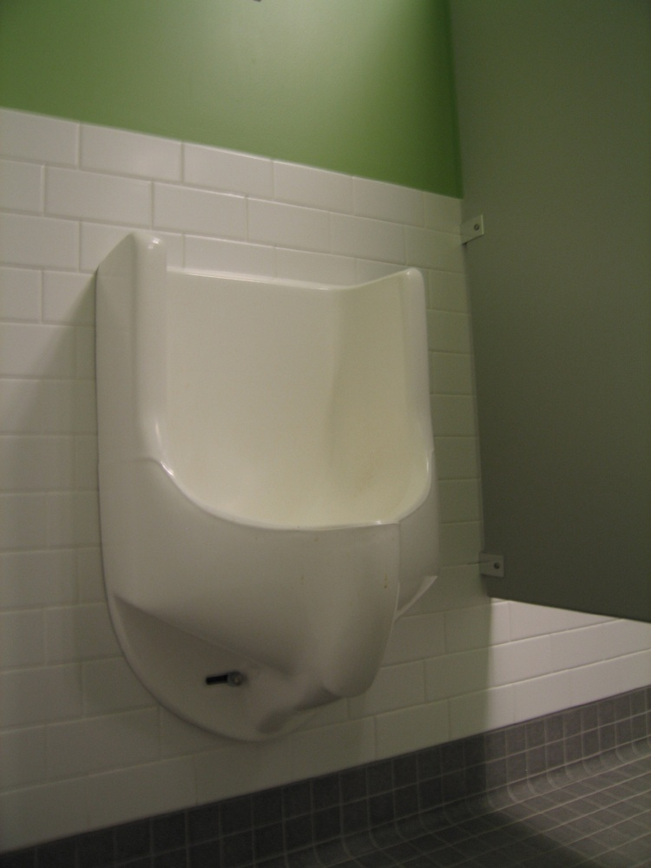
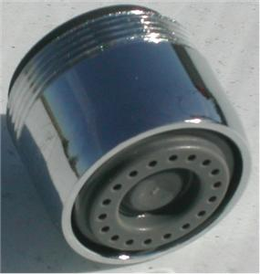
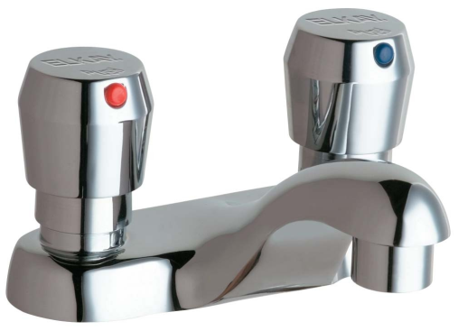
Water Reduction Projects at Tufts
Low flow toilets and urinals
Dual flush toilets
Faucet flow restrictors
Metered faucets
Notes:
Tufts has been doing a lot already to reduce its water usage through structural improvements, including
Low flow toilets and urinals
Dual flush toilets
Flow restrictors on faucets
And metered faucets
President’s Sustainability Council water working group currently working on water-related goals for Tufts, which will include
Water consumption reduction goals
Identifying water reuse opportunities
Developing metrics to measure water usage
36

Slide 37
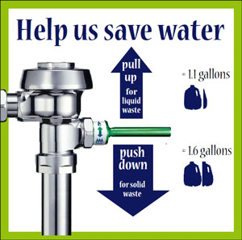
http://www.law.harvard.edu/about/administration/facilities/sustainability-pages/dual-flush-toilet-image.jpg
Notes:
Not sure how to use the dual flush toilets (they have a green handle)?
Pull up for liquid waste, push down for solid waste to conserve water

Slide 38
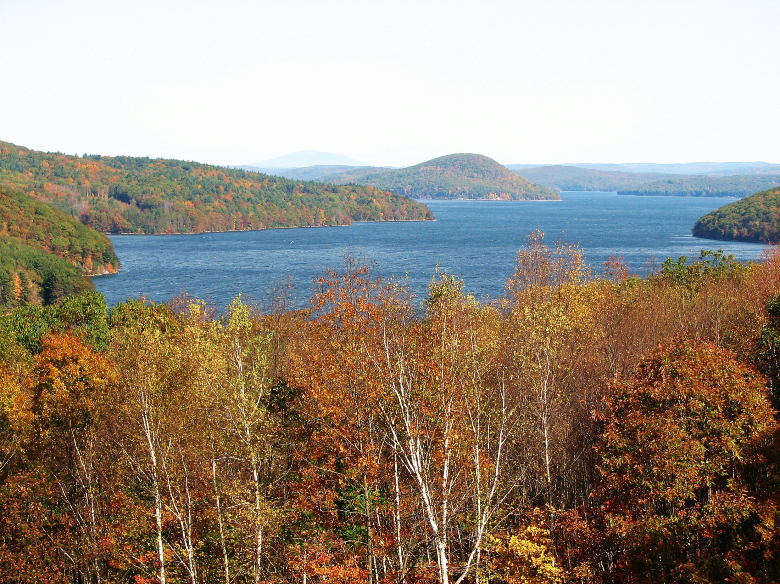
Where does Tufts’ water come from?
Source: http://v3.cache6.c.bigcache.googleapis.com/static.panoramio.com/photos/original/18972008.jpg?redirect_counter=1
Notes:
Tufts’ water comes from the Quabbin Reservoir (seen here) in Western Massachusetts
One of the cleanest water systems in the country, with low levels of pollutants
Plus, the water tastes good!

Slide 39
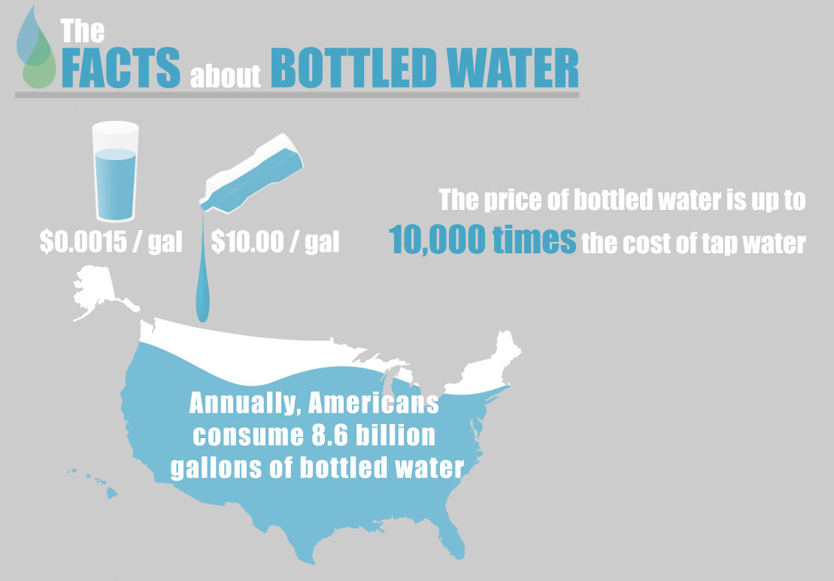
Source: http://www.onlineeducation.net/bottled_water
Notes:
Over the past decade or so, people have stopped drinking tap water in favor of bottled water, which has many negative consequences
Price of bottled water as much as 10x tap water
dani

Slide 40
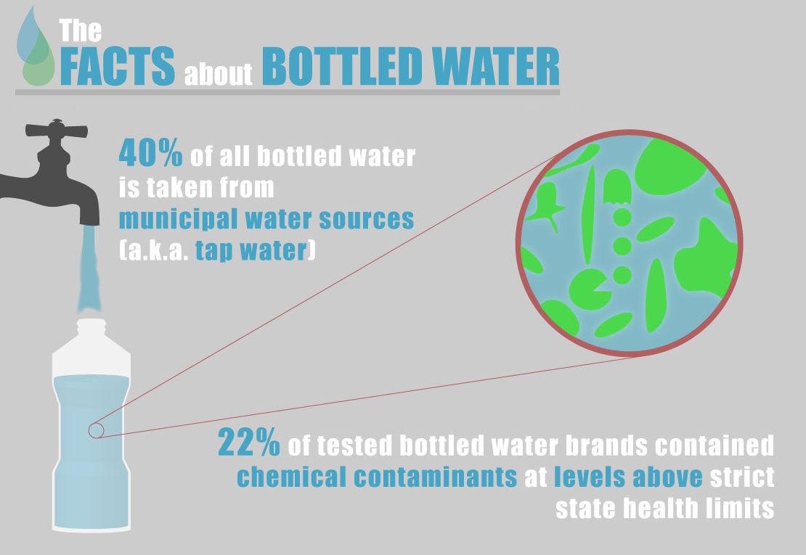
Source: http://www.onlineeducation.net/bottled_water
Notes:
40% of bottled water is tap water that is often untested – bottled water can still be distributed even if tap water standards aren’t met
22% of brands that source from tap or otherwise have contaminants above state health limits
Bottled water doesn’t have to be tested for E. coli, companies don’t have to share the source or produce quality reports

Slide 41
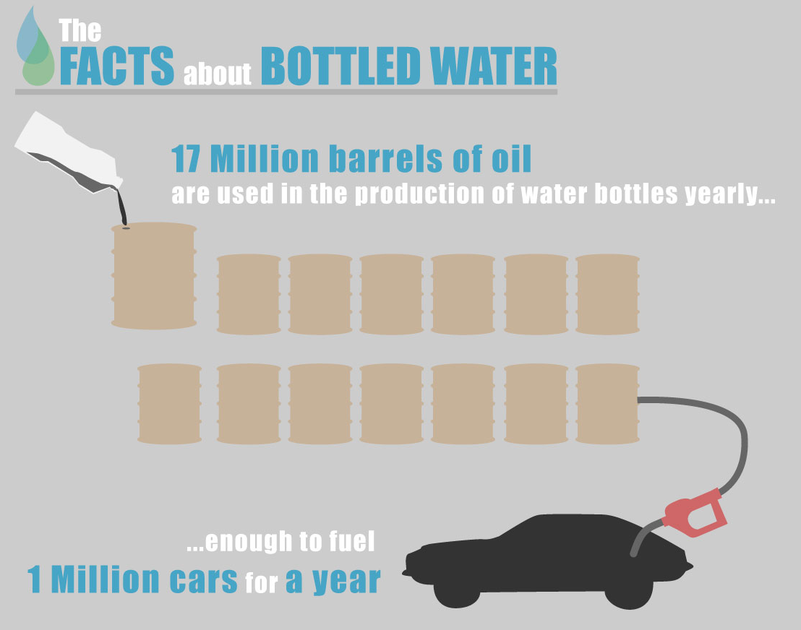
Source: http://www.onlineeducation.net/bottled_water
Notes:
To make enough bottles for bottled water consumption, it takes 17 million barrels of oil annually, enough to fuel 1 million cars
It takes 3x the amount of water to make the bottle as it does to fill it
Only 1 in 5 water bottles is recycled, the rest contribute to 3 billion pounds of waste

Slide 42
Cost of 750 gallons of water*
Individual Bottles | Poland Springs 5 gal bottles | Poland Springs water filter | Brita Filter pitcher | Tap water
$762 | $565 | $264 | $232 | $13
*750 gallons provides 1 liter of water per day to each person in a 12 person office for one year (work days only).
Example (Tisch College):
Bottled Water = $720
Filtration System = $384
Savings per year = about $336, almost 50%
Notes:
As you can see, individual bottled water doesn’t make economic sense, health sense, or environmental sense – luckily, there are many alternatives
At Tufts, we have a contract with Poland Spring, which has traditionally supplied 5 gallon bottles or individual bottles, but now offers a water filtration system
How do you get drinking water in your office?
5 gallon bottles of Poland Spring water are very expensive, unless you use < 5 bottles per month or don’t have a sink in your office
Cheapest option is tap water, which is of high quality and tastes good
you can get filtered water, either with a Poland Springs water filter or a Brita pitcher (if your office uses very little water per month)
Ex: as you can see, Tisch saved over $300 per year using filtered instead of bottled water, costs would be negligible if the office just used tap water

Slide 43
If your office uses more than 5 bottles per month, it’s cheaper and better for the planet to switch to a filtered system!
Notes:
43

Slide 44
EA Survey Results 2008-2011
Notes:
A lot of people who are wary of introducing tap or filtered water in their offices think that their colleagues won’t want to drink it
In the full EA session, we’ve had EAs do water surveys
Most people have found that their officemates are willing to drink tap water or filtered tap water
Blank is people who don’t want to fill up the brita pitcher

Slide 46
What can you do in your office?
Use tap or filtered water, not bottles
  Contact: Scott DeFeo
    Key Accounting Manager, Nestle Waters N. America
    (978) 970-5656 x 3031
    scott.defeo@waters.nestle.com
Make signs to explain water-saving features (and how to use them)
Don’t leave the water running
Have a water survey for your office
Hold a water tasting
Notes:
Use tap or filtered water, not bottles
Contact Scott DeFeo, our Poland Spring representative
Make signs to explain water-saving features (and how to use them, in the case of dual flush toilets)
Don’t leave water running while you wash dishes or your hand
Have a water survey in your office to identify barriers/benefits
Hold a water tasting to address people’s views of bottled, tap, and filtered water
Now we’re going to do a water taste test to compare Poland Spring bottled water, Poland Spring filtered water, and tap water

Slide 47
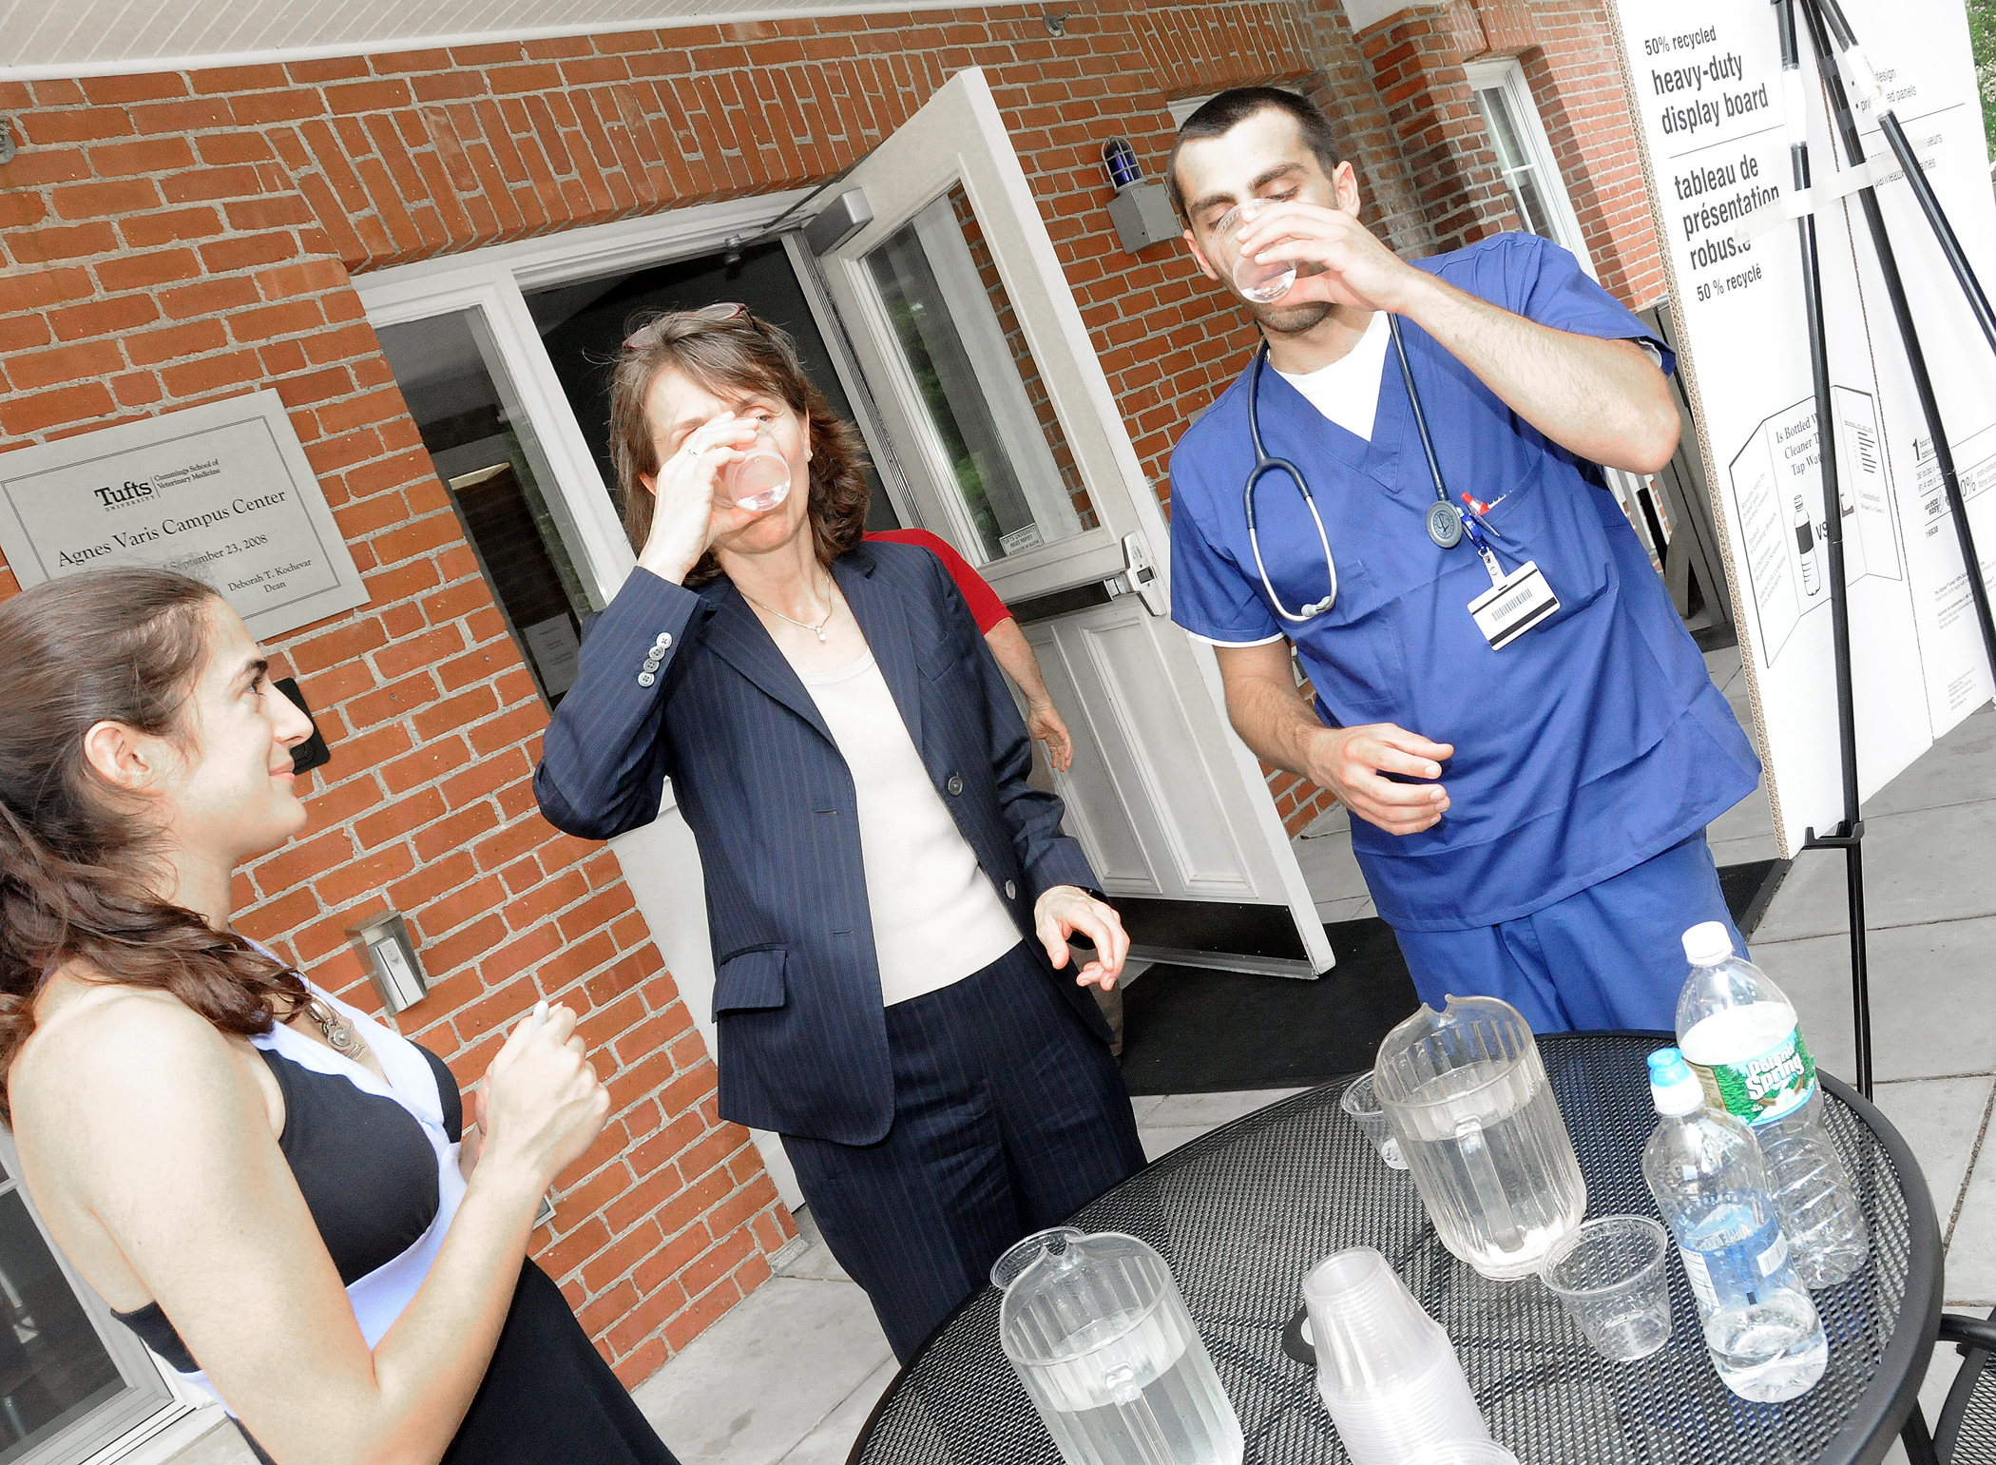
Water Tasting
Which do you prefer?

Slide 48
Social Marketing Plan
What is the problem you are trying to solve?
What is the specific behavior you are trying to change ?
Who are your primary and secondary ‘audiences’?
In what stages of change are your audiences?
Are you audience members settlers, prospectors or pioneers according to the Value Modes test?
What are some barriers to change for your audience?
What are the benefits to your audience of changing their behavior?
What communication strategies will you use to communicate with your audience? (think about the Alpha vs. Omega strategies and the stages of change strategies outlined in class).
What tools will you use? (e.g. commitments, prompts, norms, incentives, enhanced conveniences, adding infrastructure such as a drying rack, etc.)
Do you need to pilot test your campaign?
Notes:
Tina
Social Marketing Outline
What is the problem you are trying to solve (e.g. reducing paper waste in the office)
What is the specific behavior you are trying to chance (e.g. get people to use own mug instead of paper cup)
Who are your primary and secondary ‘audiences’ (e.g. the primary audience is the staff in the office, whilst the secondary audience (those who influence the primary audience) e.g. the director of the department).
In what stages of change are your audiences?
Are you audience members settlers, prospectors or pioneers according to the Value Modes test?
What are some barriers to change for your audience (e.g. physical, psychological, administrative, etc)?
What are the benefits to your audience of changing their behavior?
What communication strategies will you use to communicate with your audience? (think about the Alpha vs. Omega strategies and the stages of change strategies outlined in class).
What tools will you use? (e.g. commitments, prompts, norms, incentives, enhanced conveniences, adding infrastructure such as a drying rack, etc.)
Do you need to pilot test your campaign?

Slide 49
Some final thoughts
Share the results of the Green Office Survey with a supervisor
In a lab? Visit http://www.greencampus.harvard.edu/labs or http://www.labs21century.gov/ for some tips
Educate your colleagues
Start an office (or building, or floor) green team
Get to know your fellow Eco-Ambassadors
Don’t forget OOS!
Notes:
Share the results of the Green Office Survey with a supervisor – you can use this to track your office’s sustainability progress
If you work in a lab, visit Harvard’s lab greening website for some tips. We’re hoping to have a lab greening training in the future, so let us know if you want to get involved
Educate your colleagues about what they can do in the office using behavior change principles (refer to the social marketing handout for some ideas)
Once things get going, consider starting a green team – it’s much easier to make change in your office if you’re not the only one advocating for it
In Medford’s Tisch library, their office green team has been very successful – they’ve received Gold certification through the green office program!
Get to know your fellow EAs by talking with one another and through the blog – you can be great resources for each other and a good reminder that you’re not alone in office challenges. It can also be a lot of fun to share successes with each other, too!
Lastly, if you need help with a project and aren’t sure who to contact about something, or just want to share something good that’s going on in your office, contact Tina – we’ll be happy to help out!
49

Slide 50
Looking ahead
Assignments
Create draft social marketing plan
  Due September 7th
Meeting with EAD or existing Eco-Ambassador team
Blog entry by August 31st (http://sites.tufts.edu/ecoambassadors)
Notes:
Assignments
Continue with social marketing plan – ask if you want some assistance
Meeting with EAD (or other EAs in your building) – if you haven’t set this up already, please do so
Blog entry – on your experience with both by August 31st

Slide 51

Thanks for participating!
sustainability.tufts.edu

