Slide 1
Transportation
Eco-Ambassador Session 8
4/10/12

Slide 2
US GHG Emissions by Economic Sector - CO₂e
2008
Notes:
Table ES-8: U.S Greenhouse Gas Emissions by Economic Sector with Electricity-Related Emissions Distributed (Tg CO2 Eq.) - 2008 data shown

Slide 3
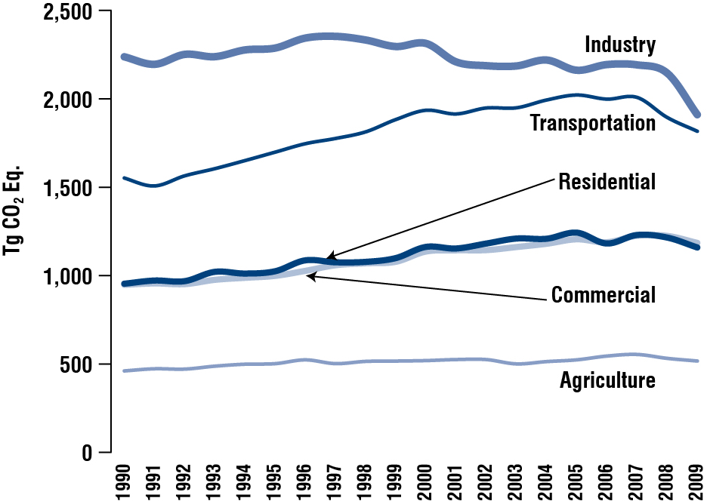
U.S. Emissions with electricity distributed to economic sectors
Notes:
Reference: Inventory of U.S. Greenhouse Gas Emissions and Sinks: 1990-2009, USEPA #430-R-11-005
http://www.epa.gov/climatechange/emissions/usgginventory.html
Note: does not include US territories

Slide 4
Tufts 2010 Emissions by Source - all campuses

Slide 5
Emissions by mode of transport
Notes:
from: http://www.epa.gov/climateleaders/documents/resources/commute_travel_product.pdf

Slide 6
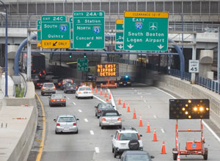
Massachusetts
3 million commuters
74% drive alone
Over 50% of New England’s ozone-forming pollutants

Slide 7
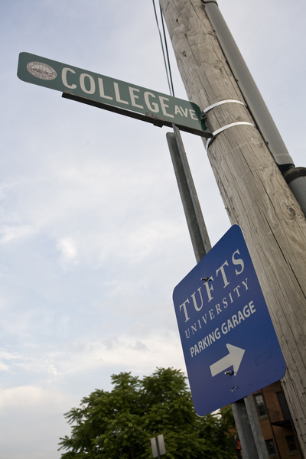
Tufts - Fall 2011
Mode | Staff & faculty | Students*
Drive alone | 64.76% | 10.62%
Carpool | 5.04% | 1.24%
Public transit | 8.86% | 13.12%
Bicycle | 4.72% | 13.62%
Walk | 7.16% | 48.72%
(the remainder worked from home or simply were not on campus that day)
*69.4% grad students, 28% juniors and seniors
Week of Nov 28-Dec 2
Notes:
Staff & faculty 200 responses – 80% were staff
Students – 318 responses – no freshmen, 0.6% sophomores, 1.6% other, 15.1% juniors, 13.2% seniors
Weather at Logan:
Monday low temp = 38, mean = 58, max – 67
Tuesday 52/57/68
Wed 48/55/66
Thurs 39/45/49
Fri 35/42/50

Slide 8
Feedback – staff & faculty
Staff don’t know about:
Emergency Ride Home
NuRide
Zipcar and Relay Rides
Bus tracking apps
Students seem aware of their options

Slide 9
Options at Tufts
Zipcar
Relay Rides
The Joey
Pre-tax transit passes and tickets
Ride-sharing (Nuride)
Emergency Ride Home
Biking and Walking
Vanpooling assistance
Bike Share
Video Conferencing
Notes:
Covered bike parking in parking garage, showers available in Gym year round
Zip car 21+ discounted application fee (50% off = $25) for current faculty/staff/students only
Commuter Benefit Program operated by Crosby

Slide 10
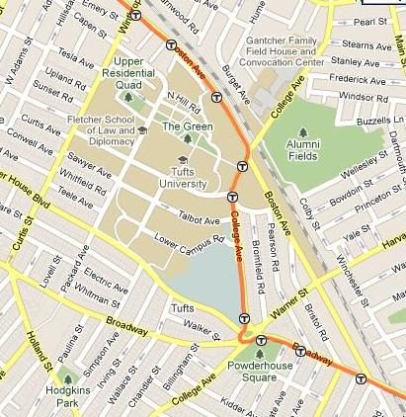
Transit Access
BUSES:
80 Lechmere/Hillside
94 West Medford
96 Harvard Square
TRAIN:
Red Line – Davis Square
MBTA Trip Planner

Slide 12
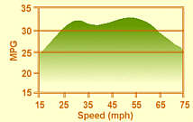
Tips on fuel-efficient driving
Avoid aggressive driving
Drive steadily
Avoid idling
Maintain properly inflated tires
Select the right gear
Use A/C sparingly on older cars, don’t worry on newer cars
Service your vehicle regularly
Tighten your gas cap
Park in the shade in the summer (sun in the winter)
Avoid short trips
Notes:
A poorly tuned engine can use up to 50% more fuel and produces up to 50% more emissions than one that is running properly.

Slide 13
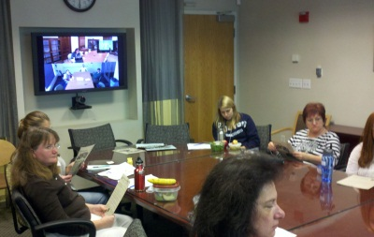
Video Conferencing Locations
Medford Campus
Cabot 7
Isobe Room (capacity - 15)
Tab 200C (capacity - 20)
Ballou Hall - Telecomm (capacity - 8)
UIT Support Center (mobile units)
Grafton Campus
Administration Building - Dean's Conference Room
Agnes Varis Campus Center – Auditorium
Boston Campus
Sackler 114
Sackler 802
Jaharis 118
Jaharis 130 (Behrakis Auditorium)
Jaharis 272
Dental 619 (CranioFacial Pain Center)
Dental 1414 (Rachel’s Amphitheatre
Supported service hours are 9am to 5pm, Mon.-Fri. Additional hours are available by appointment 5 days in advance.
There are also 2 mobile videoconference units in Boston that can be deployed at additional locations in Sackler or Dental by the Educational Media Center.

Slide 14
Additional Video Services at Tufts
Movi desktop video-conferencing
Adobe Connect
Skype
More info at http://uit.tufts.edu/?pid=759

Slide 16
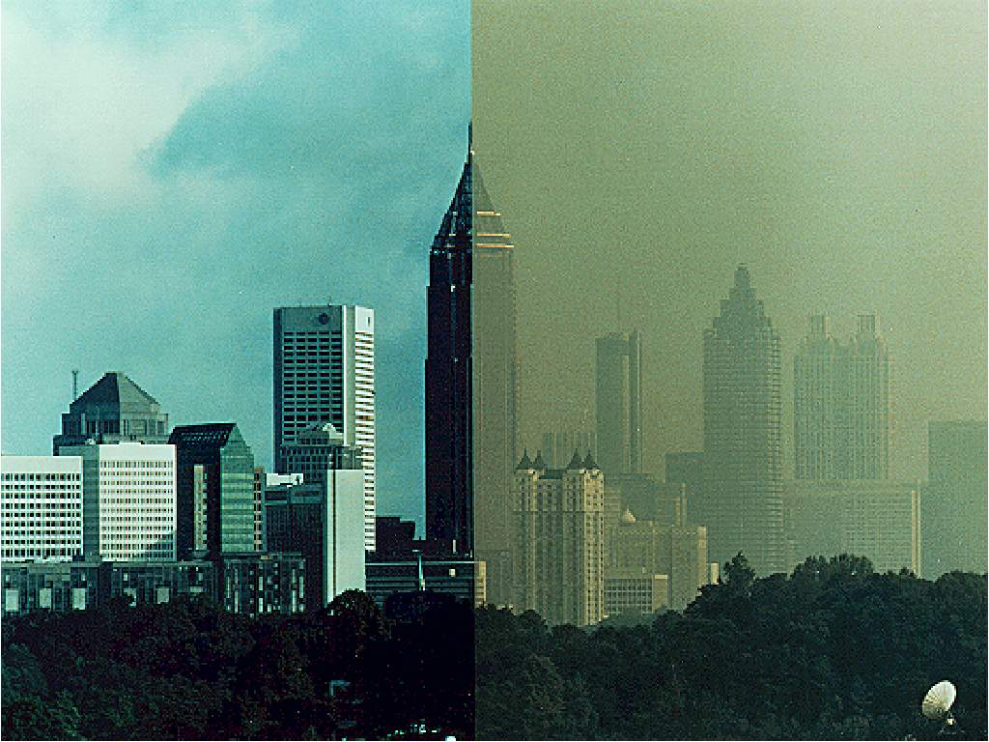
Notes:
MassRIDES is about congestion and the air we breathe.
Our goal is to reduce congestion and improve air quality. Ultimately, having less traffic on the streets and cleaner air, less smog, and reduced greenhouse gas emissions.
So what we really want? This (point to right of photo) to look more like this (left of photo).
Currently, of the 3 million people who commute in MA each day, 74% drive alone and over 50% of New England’s ozone-forming pollutants come from vehicle emissions.
We have a lot of work to do, and we need your help.

Slide 17
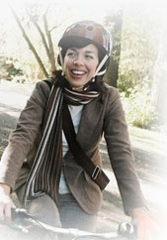
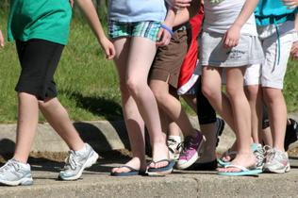
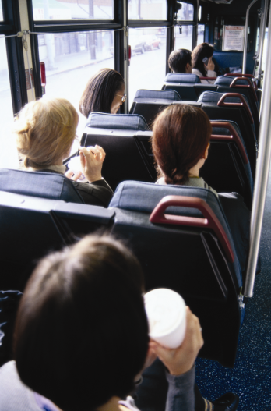
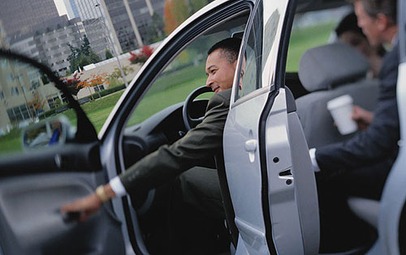
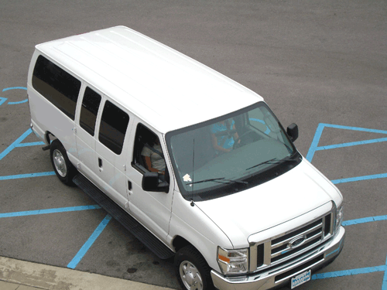
Notes:
MassRIDES is all about options. Whether your employees choose to workout on their way to work via bicycle or walking, share their trip in a carpool or vanpool, telework, or use public transportation, MassRIDES has all of the information they need.
MassRIDES is a free service of the Massachusetts Department of Transportation and is funded by the Federal Highway Administration.

Slide 18
Save Money
Reduce Parking Needs
Green Tufts
Greener Communities
Bottom
Line Benefits
Notes:
Smart companies know that offering commuter benefits not only makes the air we breathe cleaner and local roads less congested. These programs put them one step ahead of the competition, making their worksites more sustainable, helping them recruit and retain the best talent, and improving the health and well-being of their teams.

Slide 19
400+
MassRIDES Partners
Notes:
It all begins with partnership.
Over 400 of the Commonwealth’s leading businesses and organizations are already MassRIDES partners.
When you become a partner, we assign a MassRIDES coordinator to your program who has relevant regional experience for your worksite’s geographic area.
We will first conduct an analysis of your employee’s origins to identify the most relevant travel options for your location. Then, your worksite coordinator will work with you to create a customized plan to improve mobility and access to the worksite and set goals for the program. Finally, MassRIDES will help you implement this plan through worksite promotional campaigns aimed at reducing drive alone travel.
Partnership is free. All we ask is that you identify an internal champion to help us execute the plan and communicate to employees.

Slide 20
Springfield Tech CC
Student Carpool Program
Smith College
Faculty Opt-Out Program
UMass Lowell
Preferential Parking
Harvard University
Discounted Carpool Parking
MassRIDES Partner
Examples

Slide 21
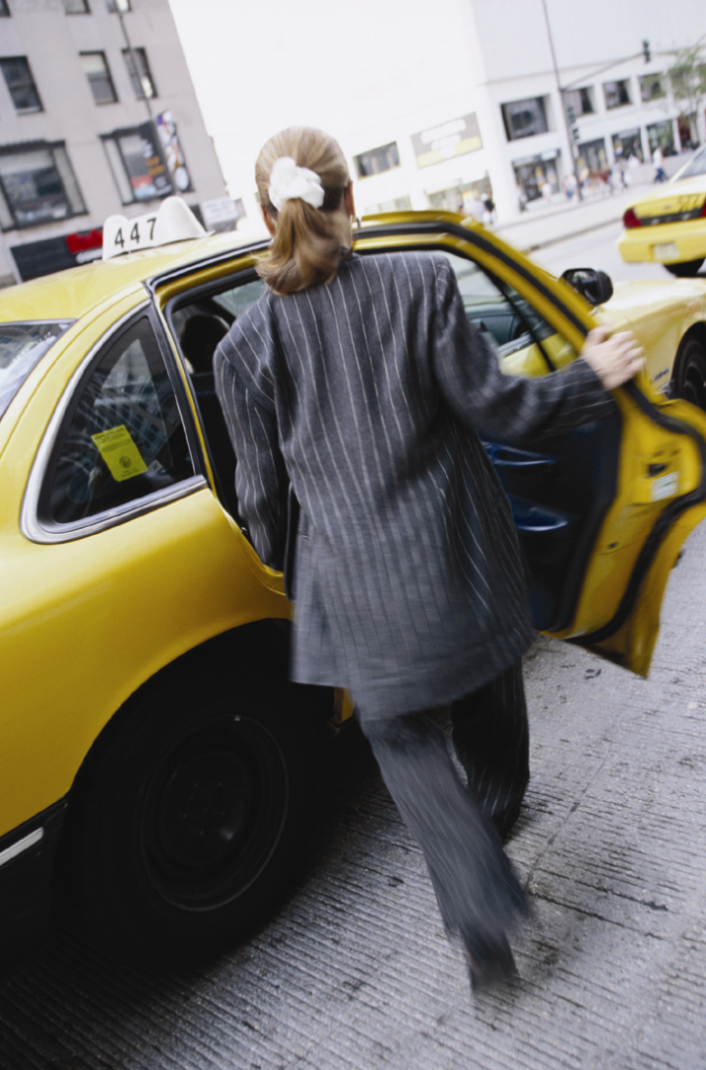
Partnership Feature: Emergency Ride Home
Notes:
Stranded is not where your employees want to be in an emergency. One of the biggest obstacles to trying a new commute is not having access to a vehicle should a personal or family emergency pop up during the day. MassRIDES has you covered. As a MassRIDES partner, you have access to the Emergency Ride Home program. MassRIDES will reimburse eligible employees for a taxi or rental car home up to four times per year in the event of an emergency. ERH is free to our employer partners.

Slide 22
DEP Results
Parking Challenges
Next Steps
NuRide
Transportation
Opportunities
Notes:
Smart companies know that offering commuter benefits not only makes the air we breathe cleaner and local roads less congested. These programs put them one step ahead of the competition, making their worksites more sustainable, helping them recruit and retain the best talent, and improving the health and well-being of their teams.

Slide 23
Partnership Feature:
Notes:
NuRide is a free benefit that you can offer to your employees.
Employees who choose to take a “greener trip” -- walking, biking, carpooling, vanpooling, public transportation, or even telecommuting-- earn points for confirming their trips at www.nuride.com. Participants can redeem those points for rewards, such as restaurant coupons or discounts at local and national retailers.
Employees who are currently driving solo can use NuRide to connect with other travelers going their same way.
Also, through MassRIDES, NuRide allows you to measure actual results for your organization, including number of participants, trips taken, emissions prevented, gas conserved, money saved, rewards earned, and even the average number of empty parking spots.

Slide 24
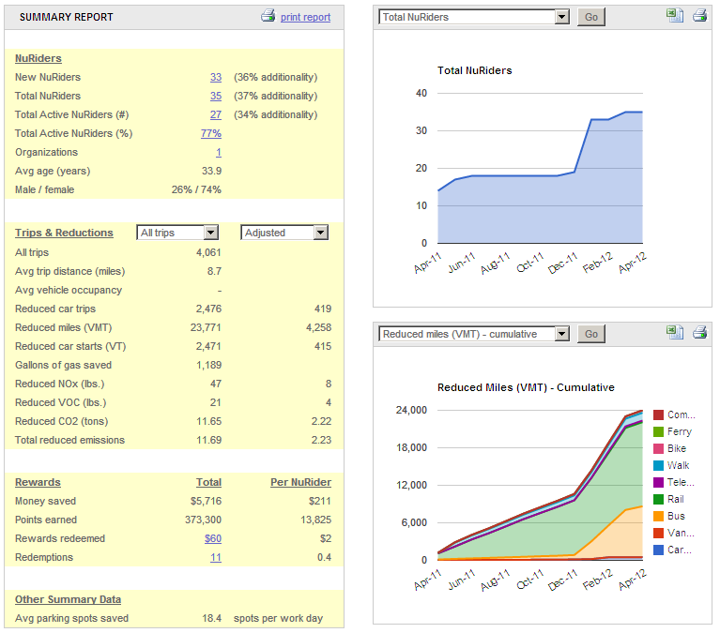
Tufts
Nuride
Data
Notes:
I am happy to take any questions at this time. Also, all those tweeters out there, please follow us on twitter at twitter.com/massrides.

Slide 25
Questions?
Ari Ofsevit
Worksite Coordinator MassRIDES
617.892.6079
ari.ofsevit@state.ma.us
www.commute.com
twitter.com/MassRIDES
Notes:
25
I am happy to take any questions at this time. Also, all those tweeters out there, please follow us on twitter at twitter.com/massrides.

Slide 26
Options for your office
Intra- or Inter-Office Challenges
Try It Days
NuRide Membership Drives
World Car Free Day on September 22nd
Host MassRides at your office (contact ari.ofsevit@state.ma.us)
Host events during Bay State Bike Week (May 14th to 20th) make it an “alternative commute to work week” with a raffle.
Pass out information on bus routes and schedules that pass by your office
Have folks calculate the real costs of owning and using a car
Suggest folks take the train to places less than 250 miles away (NYC, RI, CT, Portland) instead of flying
Encourage commuting-buddies – where people take the bus/train together
Set up an office Google Earth map that shows where everyone lives (with first names and street names or towns only) so it’s easier for folks to find people who live near them.
Try out video-conferencing
Notes:
5/14-5/20 is senior week (finals end on Friday the 12th)

